Slide 1
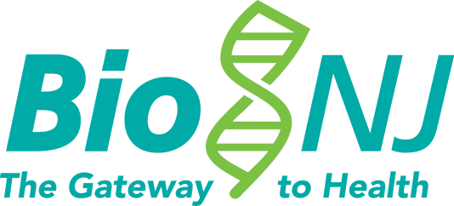



BioNJ’s Legal, Compliance & Regulatory Forum
A Day in the Life of a Biosimilar:
A Case Study
November 3, 2017
Because Patients Can’t Wait®!
Thank you to our Host Sponsor and Partners

Slide 2
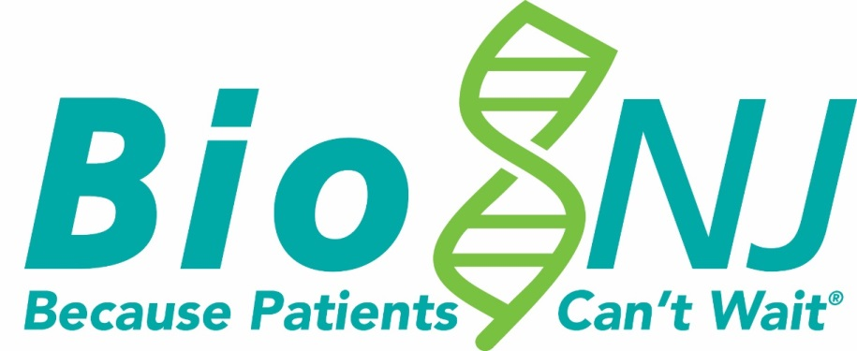

Mission:
To propel the New Jersey life sciences industry forward in support of Patients
Vision:
BioNJ is the catalyst for a robust life sciences innovation
ecosystem where:
Science is Supported,
Companies are Created, Drugs are Developed and
Patients are Paramount

Slide 3
What We Do and How Industry Benefits
Public Policy Advocacy at State and Federal Levels to
Advance Medical Innovation
Powerful Networking, Prominent Visibility and Unique Engagement Opportunities
Capital Formation, Entrepreneurship Resources,
Business Development Tools and an Extended Marketing Arm
Cost Savings on a Wide Array of
Critical Commercial Resources
  Visibility
Talent Services and
Professional Development

Slide 4
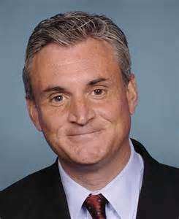
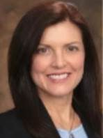
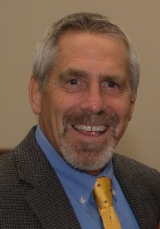
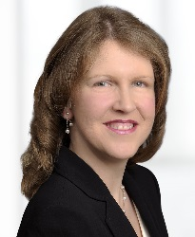
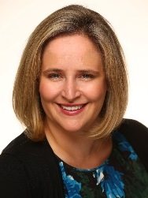
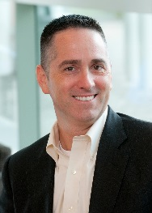
SPEAKERS
Rob Andrews
CEO, Health Transformation Alliance
(& former NJ Congressman)
Michelle Quinn, Esq.
Vice President, General Counsel
Sandoz Inc.
Gary Branning
President, Managed Market Resources & Professor
Rutgers University
Moderated by:
Linda Pissott Reig, Esq.
Shareholder & Co-Chair FDA/Biotech Section Buchanan Ingersoll & Rooney, PC
Julia Pike, Esq.
Vice President, IP, North America
Sandoz Inc.
Moderated by:
Mark Gaydos
Vice President & Head, NA Gen. Med. & Established Products/US Advertising & Promotion
Global Regulatory Affairs, Sanofi

Slide 5
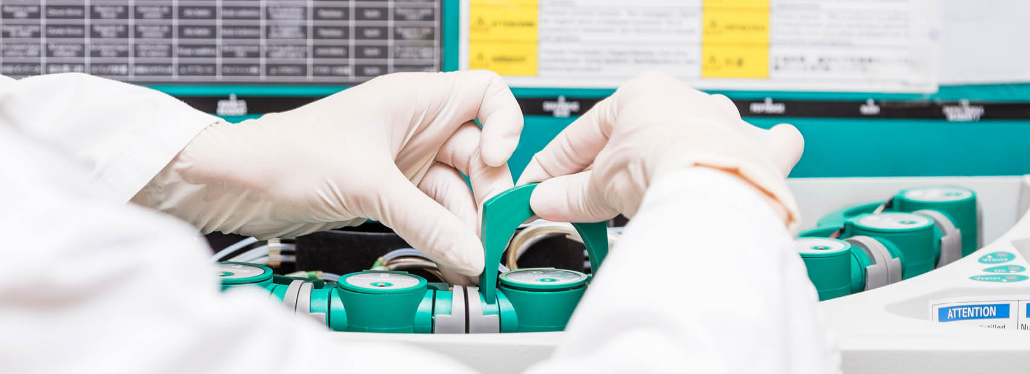
A Biosimilar Story – Sandoz’s experience to date
Sandoz US
Michelle Quinn (General Counsel), Julia Pike (VP of IP)
BioNJ
November 3, 2017

Slide 6
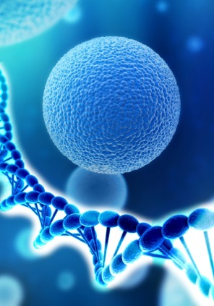
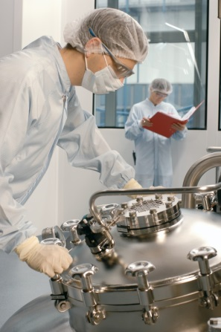
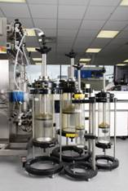
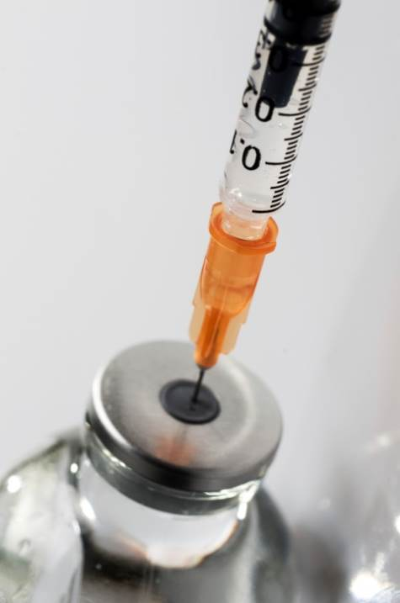
Biologics are drugs produced from living organisms
Modify host
cells
Grow
cells
Extract,
refold, purify
Formulate to stable finished drug product
(e.g. bacteria, yeast, mammalian) to produce recombinant proteins
under controlled conditions (fermentation, upstream process)
to generate drug substance (downstream process)
vial, syringe, cartridge
Adapted from EGA Handbook on biosimilar medicines; available from http://www.egagenerics.com/index.php/publications/

Slide 7
8 of the top 10 molecules worldwide were biologics in 2016
Product | Manufacturer | Type | 2016 FY (USD)
1. HUMIRA® | AbbVie | Biologic | 16,000,000,000
2. HARVONI® | Gilead | Small molecule | 9,100,000,000
3. RITUXAN® | Roche | Biologic | 7,300,000,000
4. REVLIMID® | Celgene | Small molecule | 7,000,000,000
5. REMICADE® | J&J | Biologic | 7,000,000,000
6. AVASTIN® | Roche | Biologic | 6,700,000,000
7. HERCEPTIN® | Roche | Biologic | 6,700,000,000
8. OPDIVO® | BMS | Biologic | 6,400,000,000
9. ENBREL® | Amgen | Biologic | 6,000,000,000
10. LANTUS® | Sanofi | Biologic | 4,800,000,000
Source: Company earnings statements; all rounded to nearest 100M. Note: All trademarks are the property of their respective owners.

Slide 8
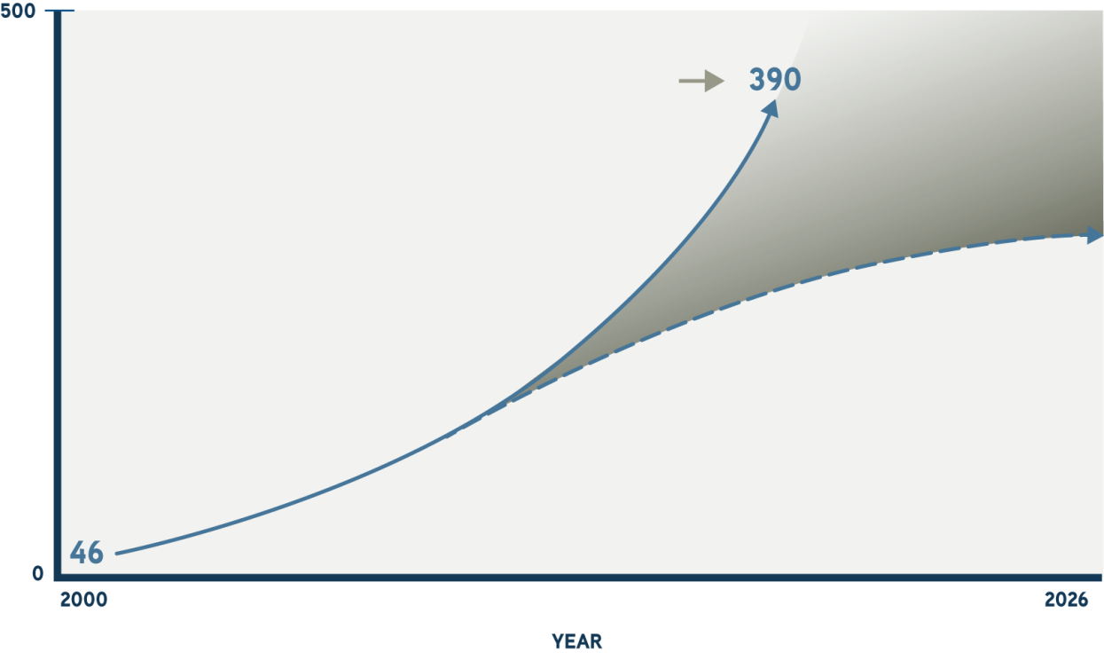
Projected impact of biosimilars in the biologic market
Up to $250 BILLION
in potential global savings
by 2026
Biologics projected to be
28% of the global market
in 2020, totaling $390 billion
Biologic Market
(In Billions of Dollars)
GPHA. Savings and access report. 2016.

Slide 9





Biosimilars proven to be safe and effective, regulations are developing worldwide
EU draft general guidelines adopted
First bio-
similar somatropin launched in EU by Sandoz
First bio-
similar epoetin launched in EU by Sandoz
Filgrastim¹ launched in EU (Teva)
EU adopts monoclonal antibody guidelines
First mAb biosimilar launched in EU (Celltrion)
First bio-
similar etanercept launched (Samsung/
Biogen)
2004
2005
2006
2007
2008
2009
2010
2012
2014
2015
2016
2017
Sandoz somatropin first biosimilar-type medicine launched in US
Japan biosimilars regulatory guidelines established
US creates abbreviated approval pathway for biosimilars
as part of the Affordable Care Act (BPCIA)
CMS finalized provision for biosimilars
China announced final biosimilar guidance
FDA issued labelling guidelines and releases draft naming guidance
Supreme Court decision on the BPCIA, eliminating 6 month delay for all biosimilars
Sandoz soma-tropin first bio-similar approved and launched in Japan and Canada by Sandoz
First ever biosimilar, Zarxio (filgrastim) launched in US by Sandoz
Sandoz driven event

Slide 10

Global biosimilar approvals; ~41 in Europe, 7 in the US...
US
Biosimilar | Sponsor | Approved | Reference biologic
Zarxio® (ﬁlgrastim-sndz) | Sandoz | Mar 2015 | Neupogen®
Inﬂectra® (inﬂiximab-dyyb) | Celltrion/Pﬁzer | Apr 2016 | Remicade®
Erelzi® (etancerpt-szzs) | Sandoz | Aug 2016 | Enbrel®
Amjevita® (adalimumab-atto) | Amgen | Sep 2016 | Humira®
Renflexis® (infliximab-abda) | Samsung Bioepis | Apr 2017 | Remicade®
Cyltezo® (adalimumab-adbm) | Boehringer Ingelheim | Aug 2017 | Humira®
Mvasi® (bevacizumab-awwb) | Amgen | Sep 2017 | Avastin®
EUROPE
Ingredient | Medicine name | Approved
Insulin glargine | Lusduna® | 2017
Trastuzumab | Ontruzant | 2017*
Adalimumab | Amjevita | 2017
Rituximab | Rixathon | 2017
Rituximab | Blitzima | 2017
Rituximab | Truxima | 2017
Adalimumab | Cyltezo | 2017*
Adalimumab | Imraldi | 2017
Teriparitide | Movymia | 2017
Teriparitide | Terrosa | 2017
Etanercept | Erelzi® | 2017
Etanercept | Benepali® | 2016
Enoxaparin sodium | Thorinane®/ Inhixa® | 2016
Inﬂiximab | Flixabi® | 2016
Insulin glargine | Abasaglar® | 2014
Filgrastim | Accoﬁl (formerly Abasria) ® | 2014
Follitropin alfa | Bemfola® | 2014
Inﬂiximab | Remsima®/Inﬂectra® | 2013
Filgrastim | Grastoﬁl® | 2013
Follitropin alfa | Ovaleap® | 2013
Filgrastim | Nivestim® | 2010
Filgrastim | Zarzio® | 2009
Filgrastim | Tevagrastim®/Ratiograstim® | 2008
Epoetin zeta | Silapo®/Retacrit® | 2007
Epoetin alfa | Abseamed® | 2007
Epoetin alfa | Binocrit® | 2007
Somatropin | Omnitrope® | 2006
Source: European Medicines Agency website

Slide 11
Biosimilar development: high investment, closer to originators than to generics
 |  | GENERIC | BIOLOGIC | BIOSIMILAR
 | Development cost ($US) | 2–3 million | 800 million | 100–300 million
 | Time to market (years) | 2–3 | 8–12 | 7–8
 | Clinical studies | Bioequivalence studies in healthy volunteers | Phase I-III efficacy and safety studies | Comparative PK/PD and Phase III studies/clinical confirmation study, as needed
 | Patients (n) | 20–50 | 800–1000 | ~500
 | Post-approval activities | Pharmacovigilance | Phase IV, Risk Management Plan including Pharmacovigilance | Phase IV, Risk Management Plan including pharmacovigilance (as needed)

Slide 12


Difference between originator and biosimilar development
Comparison with the reference product
Originator development
Biosimilar development
In the end, both approaches provide the same level of confidence
with regard to safety and efficacy of the product
Clinical
Clinical
Clinical
PK/PD
PK/PD
The world turned
upside down ...
PK/PD
Non-clinical
Pre-clinical
Pre-clinical
Analytical
Analytical
Analytical
Development costs:
US$ 800 mn
Development costs:
US$ 100-300 mn
Sources:http://www.fda.gov/downloads/Drugs/GuidanceComplianceRegulatoryInformation/Guidances/UCM078749.pdf Accessed July 10, 2015
McCamish M, Woollett G. The state of the art in the development of biosimilars. Clin Pharmacol Ther. 2012;91(3):405-17Paul SA 2010 Nature Reviews Drug Discovery 9:203-214

Slide 13

Analytical Characterization of a reference product
“Patients and health care professionals are able to rely upon the safety and effectiveness of biosimilar products, in the same manner as for the reference product.” - Steven J. Lemery, FDA
Primary structure e.g.:
LC-MS intact mass
LC-MS subunits
Peptide mapping
Higher order structure e.g.:
NMR
CD spectroscopy
FT-IR
Impurities e.g.:
CEX, cIEF acidic/basic variants
LC glycation
Peptide mapping deamidation,
oxidation, mutation, glycation
SEC/FFF/AUC aggregation
Post translat. modif. e.g.:
NP-HPLC-(MS) N-glycans
AEX N-glycans
MALDI-TOF N-glycans
HPAEC-PAD N-glycans
MALDI-TOF O-glycans
HPAEC-PAD sialic acids
RP-HPLC sialic acids
Biological activity e.g.:
Binding assay
ADCC assay
CDC assay
Combination of attributes e.g.:
MVDA, mathematical algorithms
Berkowitz SA, et al. Nat Rev Drug Discov 2012; 11(7): 527–540; http://www.fda.gov/downloads/AdvisoryCommittees/CommitteesMeetingMaterials/Drugs/AdvisoryCommitteeforPharmaceuticalScienceandClinicalPharmacology/UCM315764.pdf Accessed July 10, 2015

Slide 14
Understanding the target: Variability of originator references defines goalposts for biosimilars
Comparison of the different pre- and post-change batches of Rituxan®/MabThera® (rituximab)
Acidic
variants
Basic
variants
60
Basic variants
[rel. area %]
50
Pre-change
Post-change
40
30
20
Post-change
Pre-change
10
0
08.2007
12.2008
05.2010
09.2011
14
18
22
26
30
t [min]
Expiry date
Comparison of the different pre- and post-change batches of Enbrel® (etanercept)
G2F
60
G2F glycans
[rel. area %]
50
Pre-change
G0F
(1,6)G1F
(1,3)G1F
40
G2
Pre-change
30
Post-change
G0
20
Man5
Post-change
10
10
15
20
25
30
35
40
0
02.2008
03.2009
05.2010
06.2011
t [min]
Expiry date
All trademarks shown in this slide deck are the property of their respective owners. Enbrel is a registered trademark of Immunex Corporation
Source : Nat. Biotechnol. 2011; 29: 310-312

Slide 15
FDA and EMA regulatory principles on biosimilars
Biosimilars are “essentially the same” as their reference product
Biosimilar development to establish biosimiliarity not re-prove efficacy
Clinical study to represent most sensitive model to study differences
Scientifically not “abridged” , but rather “tailored“ development
Similar analytical and PK/PD data means lower risk of clinical differences

Slide 16
Key issues still need to be addressed in the US
Naming
Approved final guidance on naming required
Labelling
Final guidance on labelling required
Interchangeability
Clarification of clinical requirements is needed
IP provisions
Complex litigation process
Review time
Biologic/Biosimilars product reviews require sufficient FDA resources

Slide 17
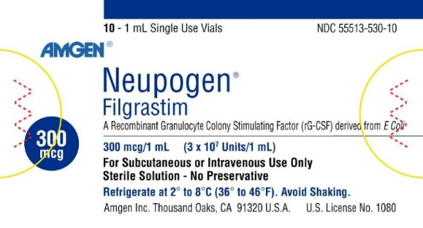
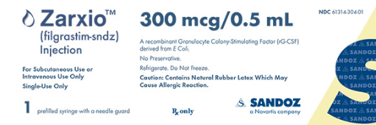
Naming for all biologics in US
Brand
name
INN/USAN
4-letter
suffix
All trademarks are the property of their respective owners
Note: Distinguishable packaging, colors schemes, designs, barcodes and other features

Slide 18
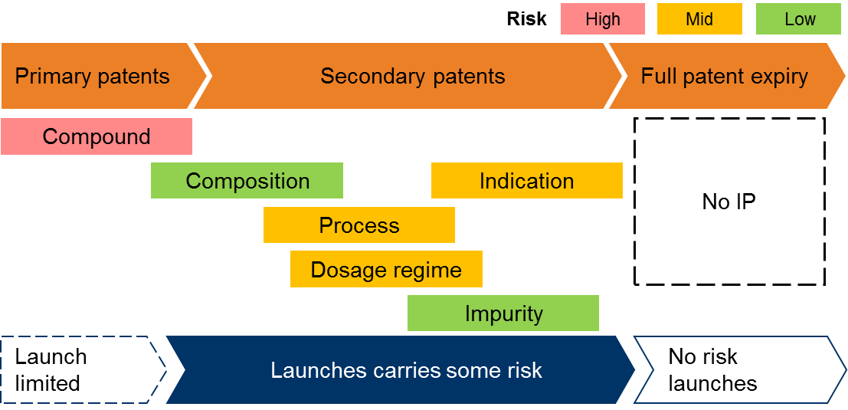
The IP covering biosimilars is essentially the same as for small molecules

Slide 19
Biosimilars IP litigation: not your grandma’s pharma patent litigation
This is not Hatch-Waxman:
  No linkage between regulatory status and patent litigation ie. biosimilars can “launch at risk” before any decision on patents
  No 180 day exclusivity for the first biosimilar to challenge patents
  Brand is guaranteed 12 years of market exclusivity – only ~5 years for small molecules
  BPCIA and “patent dance” has new strategic opportunities and challenges to resolve patent risk
For every branded product, any biosimilar represents a significant threat to their total income
  We expect them to fight with everything they have
  Success in this space demands commitment, deep pockets and extensive IP and litigation skills

Slide 20


Let’s talk about the BPCIA; any new law will have kinks to work out, but this is ridiculous...

Slide 21
Sandoz’s Supreme Court win has shaped the BPCIA for the future
Sandoz was the first to navigate the new BPCIA statute, and to take on two key elements of the elaborate processes it contained
  When to give the brand 180 days notice of the biosimilar’s intention to launch (the “notice of commercial marketing”); and
  Whether biosimilars could be forced to engage in the “patent dance” by disclosing our FDA application and manufacturing information to the brand
Sandoz’s Supreme Court win means:
  All biosimilars will be able to launch on the day they are approved, removing the 180 day delay
  Biosimilars can potentially speed up the resolution of any patent litigation, rather than waiting for the “patent dance” to end
  Increased clarity on how the BPCIA works, reducing unnecessary litigation and costs

Slide 22
Many battles still to come under the BPCIA, and on IP for biosimilars
So you don’t have to dance, but what are the rules of the dance if you do?
  Genentech v Amgen/ Amgen v Genentech on bevacizumab
  Amgen v Hospira on EPO
Will IPRs survive Oil States v Greene’s Energy?
How will the courts view preliminary injunction requests?
Will companies have to share their settlement agreements with the FTC?

Slide 23
Engaging stakeholders on biosimilars will be key to driving access and uptake
Advocate for policy measures
Collaborate with payors
Educate
physicians
Regulatory engagement to appropriately shape policy
Payor alignment on balancing cost saving opportunities with industry sustainability
Build confidence in biosimilar concept
Deliver needed patient support and education
Provide
access
Broad patient advocacy engagement and tailored support services
Engage through multiple channels to achieve broad access

Slide 24
Two final thoughts:
1
Biologics are critical to the future of modern healthcare.
There is still much to do to realize the promise of biosimilars.
2

Slide 25
A Day in the Life of a Biosimilar:
A Case Study
The Right Strategy?

Slide 26
Biosimilars – US Status
Public Health Service Act
The Biologics Price Competition and Innovation Act (BPCI Act) was passed as part of the Affordable Care Act that President Obama signed into law on March 23, 2010
BPCI Act creates an abbreviated licensure pathway for biological products shown to be biosimilar to or interchangeable with an FDA-licensed reference product [section 351(k) of the Public Health Service Act].
THIS IS DIFFERENT FROM…
Federal Food Drug and Cosmetic Act (FFDCA)
The Abbreviated New Drug Application process in section 505(j) was established through the 1984 Hatch-Waxman Amendments to the FFDCA thus creating the generic drug program for “small molecule” drugs

Slide 27
Summary of 2018 Part D Benefit
DEDUCTIBLE | INITIAL COVERAGE LIMIT (ICL) | COVERAGE GAP ("DONUT HOLE”) | CATASTROPHIC COVERAGE
$405 | $3,750 | Total drug spend is >$3750 with a Coverage Threshold of $8,418 | Total drug spend >$8,418 with Patient out-of-pocket (OOP) is over $5,000
Beneficiary pays 100% | Plan pays 75% | BRANDS: Manufacturer discount 50% Beneficiary pays 35% Plan pays 15% | Federal government pays 80% through reinsurance subsidy (to plan)
 | Beneficiary pays 25% | GENERICS/BIOSIMILARS: Beneficiary pays 44% Plan pays 56% | Plan pays 15%
 |  | [Note: Manufacturer discount of 50% is included in Patient Out of Pocket, contributing to the $5,000] | Beneficiary pays greater of 5% of drug cost or $8.35 for brands ($3.35 for generics)

Slide 28
Launch will be like a Brand… Not a Generic
Product Launch Plan
  Product Value Proposition
  Positioning and Messaging
  Target Audience
  Physician and Payer Education
  Patient Marketing and Support
Sales Force
  Effort level and deployment
  Incentives
  Training
Pricing and Access
  Account Management Team
  Contracting & Gross to Net
Product Supply – Manufacturing and Distribution
  Supply Chain Management
  Specialty Pharmacy Network
Payer Expectations
Appropriate Discounts
Value beyond Price
  Mode of Administration
  Therapy Area/Indication(s)
  Comparable Patient Programs
  Physician Education
  Field Sales Team
  Experience with Biologics
2/3 of pharma product launches fail to meet expectations

Slide 29
Physician adoption of biosimilars – Depends:
Insight | Implications
 | Physicians are inclined to resist payer-directed patient switching in the absence of sufficient biosimilar clinical trial data
 | Physician selection of biosimilars could be directed toward well established proven biologic manufacturers
 | Biosimilar discount levels will affect physician willingness to prescribe
Robust data
Manufacturer trust
Cost
Physician Response:
Appeals (based on extrapolation, interchangeability, lack of medical rationale, etc.) and Grandfathering requests

Slide 30
Payers are interest – Depends:
Insight | Implications
 | Significant discounts required to actively shift stable patients
 | Could continue to prefer originator if manufacturers provide additional rebates
 | May actively manage when robust clinical data is available
Naïve patients
Lower costs
Physician resistance
Payer Response:
Physician education, Differential reimbursement (co-pay/co-insurance/ASP), Step edits to create passive adoption through economic incentives

Slide 31
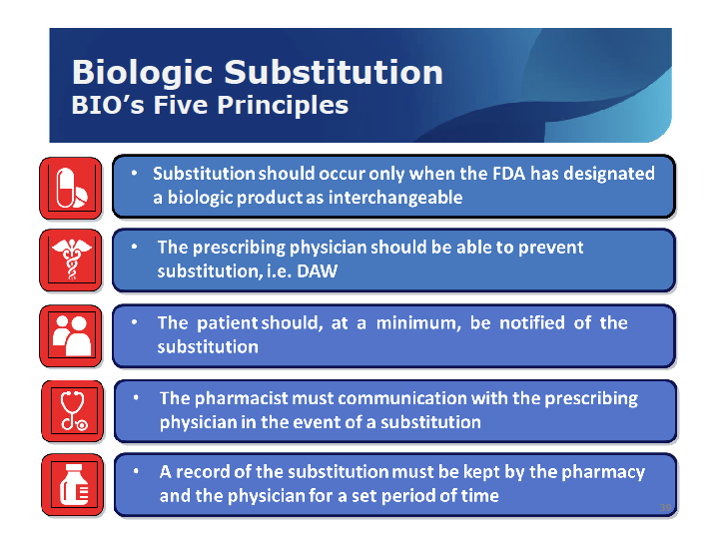

Slide 32
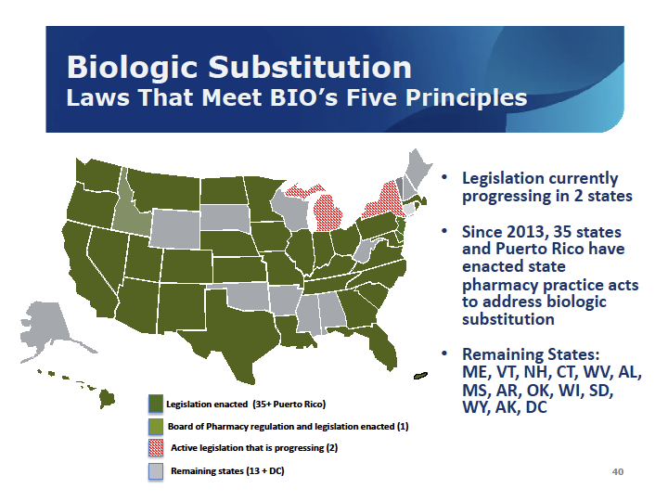

Slide 33

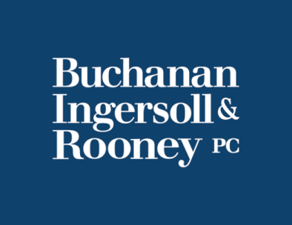
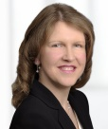

A Day in the Life
of a Biosimilar:
A Case Study
Linda Pissott Reig, Esq.
Shareholder & Co-Chair
FDA/Biotech Section
Buchanan Ingersoll & Rooney, PC
Mark Gaydos
Vice President & Head, NA Gen. Med. & Established Products/US Advertising & Promotion, Global Regulatory Affairs, Sanofi

Slide 34
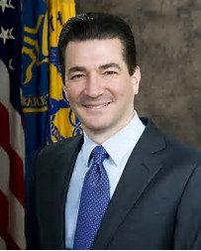
“This is an opportunity where payers might have a role to play by guaranteeing perhaps some market share to some of the biosimilars that are coming onto the market and then driving the adoption themselves.”
“What I worry about is that if the adoption rates continue to be slow then the potential manufacturers of biosimilars won’t see this as a viable opportunity and won’t make the investments in the first place. If they don’t think that they can capture 20% or 30% of market share within the first five years of being on the market, or whatever the economic model is, they might say this is a category we’re going to stay away from.”
Scott Gottlieb, US FDA Comm’r Comments at 9/18 Chasing Cancer Summit hosted by Washington Post (Pink Sheets, 9/22/17)

Slide 35

How can I drive greater market uptake of my biosimilar?
Doctors don’t understand them.
Payors, for some reason, seem less than enthusiastic.
Patients don’t seem to be clamoring for them
All this despite the lower price at which I am (or will be) offering it.

Slide 36

How do I estimate the costs?
Here I have, among other things,
R&D costs, plus User Fees to file,
BUT ALSO: I need to prepare for the
patent wars (i.e. PTAB proceedings & court costs, plus potential jury verdicts for infringement) – and all this even before my biosimilar reaches market?

Slide 37
“People in a competitive market, in a dynamic market, price things to the price they can derive and what they perceive the value to be and what the value is to the end recipent. Products aren’t price based on some multiple of what it costs to develop them.”
Scott Gottlieb, US FDA Comm’r Comments at 9/18 Chasing Cancer Summit hosted by Washington Post (Pink Sheets, 9/22/17)

Slide 38
How do Biosimilars compare to Generics in terms of
Safety oversight & PI Updating
Marketing & Sales Initiatives
Pricing or Customer Service Differentiators
Etc.

Slide 39

How do I engage the payors and obtain the buy-in for my biosimilar?
How do I factor in outside forces, such as newly organized large self-insured employers?
Is there perhaps a way to partner with them to push market share in my direction?

Slide 40

What about if I am the innovator?
What tactics can I use to delay the uptake of biosimilars in the market?
What about strategies such as
sham patents, “REMS as a shield” or contracts with payors or hcps to block biosimilar entry

Slide 41
What can we learn from experience with biosimilars overseas?
How does the US experience so far with biosimilars play into what we should view as “best practices” for rapid biosimilar approval & marketplace success?

